Slide 1

LINEAR REGRESSION
Subject: Machine Learning
NAME | PRN
LIKHITA REDDY | 19030141031
MOHIUDDIN AHMED | 19030141039
AAYUSHI RAMDHAM | 19030141054

Slide 2

MACHINE LEARNING
Machine Learning is a branch of Artificial Intelligence concerns the construction and study of Systems that can learn from DATA.

Slide 3
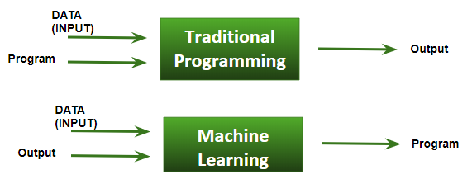
BASIC DIFFERENCE IN ML AND TRADITIONAL PROGRAMMING

Slide 4
MACHINE LEARNING ALGORITHM TYPE
Supervised Learning
Unsupervised Learning
Semi-Supervised Learning
Reinforcement
Learning
When the model is getting trained on a labeled
dataset.
Labeled dataset is one which have both input and output parameters.
The training of machine using information that is neither classified nor labeled and allowing the algorithm to act on that information without guidance.
When we are dealing with a data which is a little bit labeled and rest large portion of it is unlabeled.
The model keeps on increasing its performance using a Reward Feedback to learn the behavior or pattern.

Slide 5
MACHINE LEARNING ALGORITHM TYPE
Supervised Learning
Unsupervised Learning
Semi-Supervised Learning
Reinforcement
Learning
When the model is getting trained on a labeled
dataset.
Labeled dataset is one which have both input and output parameters.
Classification
(Defined Labels)
Regression
(No Labels Defined)

Slide 6
TYPES OF REGRESSION
Linear regression
Logistic regression
Polynomial regression
Stepwise regression
Ridge regression
Lasso regression
Elastic Net regression
Ordinal Regression

Slide 7
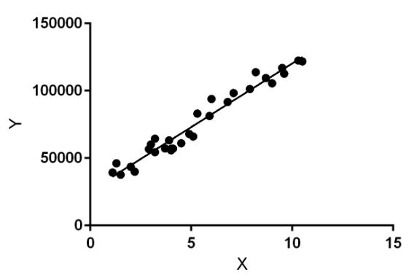
LINEAR REGRESSION
It is the simplest form of regression. It is a technique in which the dependent variable is continuous in nature. The relationship between the dependent variable and independent variables is assumed to be linear in nature.

Slide 8
TYPES OF LINEAR REGRESSION
LINEAR REGRESSION
SIMPLE LINEAR REGRESSION
MULTIPLE LINEAR REGRESSION

Slide 9
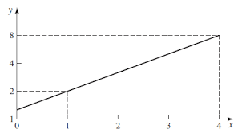
MOTIVATION
Purpose is to built functional relationship (Model) between dependent variable(s) and independent variable(s)
EXAMPLE:
What is the effect of prices on sales.
Why we are doing this ?
Can be used to fix the selling price of the item, So as to increase the market share

Slide 10
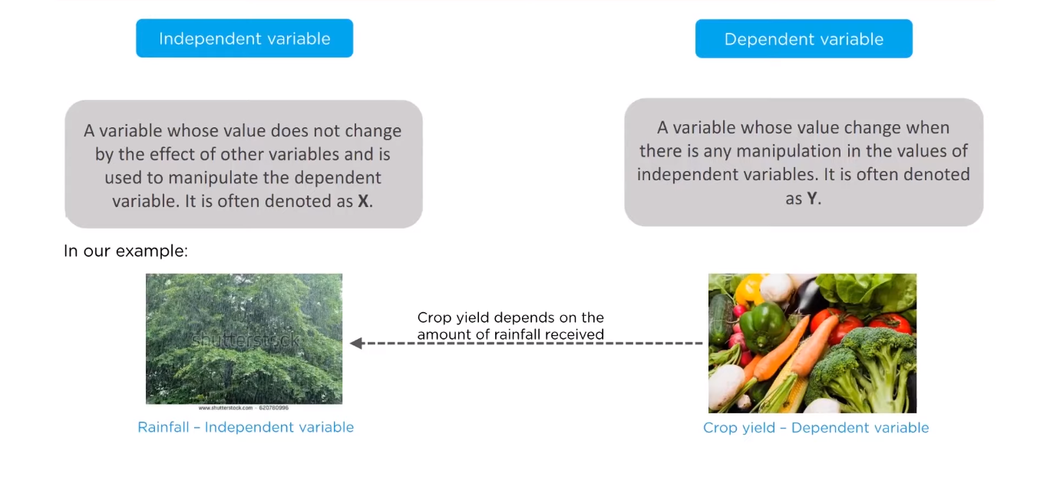
DEFINITION AND EXAMPLE

Slide 11
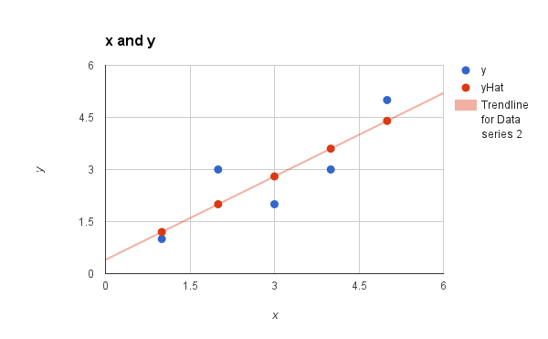
SIMPLE LINEAR REGRESSION MODEL
Only one independent variable, x
• Relationship between x and y is described by a linear function
• Changes in y are assumed to be caused by changes in x
Assumption
Means Y is linearly related to X
E(ε) = 0

Slide 12
SIMPLE LINEAR REGRESSION MODEL
Y- intercept
Slope Coefficient
Independent
Variable
Random
Error term
Dependent
Variable
Y = β_{o} + β₁ X + ε
Linear component
Random
Error component

Slide 13
MULTIPLE LINEAR REGRESSION MODEL
Average change in Y
For a unit change in X1,
Holding constant X2
Average change in Y
For a unit change in X1,
Holding constant X2
Y- intercept
Independent Variable
Dependent Variable
Y = β_{o} + β₁ X₁+ β₂ X₂ + ε
Random
Error term
Independent Variable

Slide 14

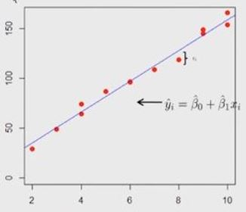
LINEAR REGRESSION MODEL
Error is in the dependent variable and not in the independent variable
Y
x

Slide 15
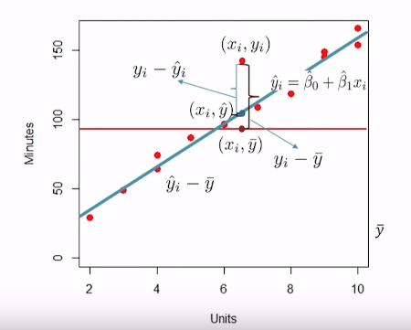
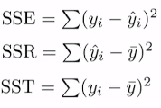
TYPES OF ERRORS
Sum of Squared Residuals=
Sum Square Total(SST)-
Sum Squared Errors(SSE)
SSR= Predicted value – Mean value

Slide 16



Sum of squared errors (SSE):
The minimization of SSE gives estimates of

Slide 17

COEFFICIENT OF DETERMINATION
Coefficient of determination – R ² is a measure of variability of in output variable explained by input variable.
R ² values : Between 0 and 1
Values close to 0 states poor fit.
Values close to 1 indicates good fit.(However, should not be used as a sole criteria to judge the linear model is adequate).

Slide 18
DATASET
MARKETING SPEED
R & D SPENDING
EXPENDIT-URE OF COMPANY
PROFIT
STATE
ADMINISTRATION

Slide 19

PYTHON IMPLEMENTATION
Independent Variable
Dependent Variable

Slide 20
RESIDUALS OF ERROR
LINEAR RELATIONSHIP BETWEEN R&D AND PROFIT
Residuals
of Error
Research and development
Profit

Slide 21
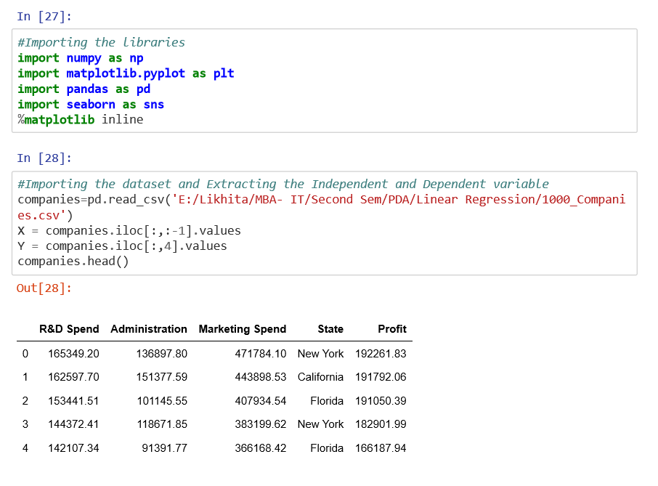
IMPORT THE DATA SET AND SET OUR VARIABLES

Slide 22
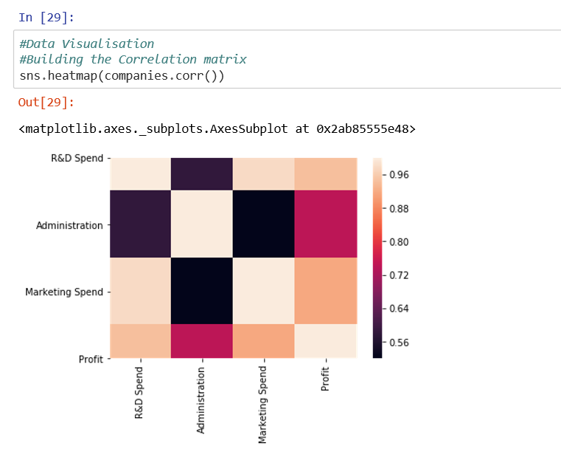
VISUALIZATION

Slide 23
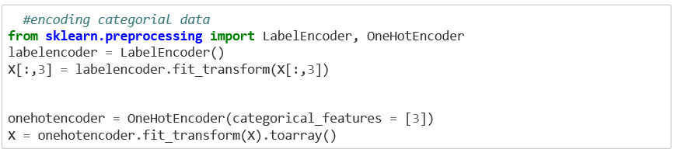
LINEAR REGRESSION USING SKLEARN
Encoding Categorical Data

Slide 24
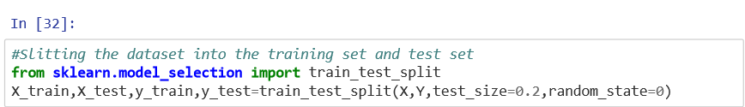
SLITTING THE DATASET INTO THE TRAINING SET AND TEST SET

Slide 25
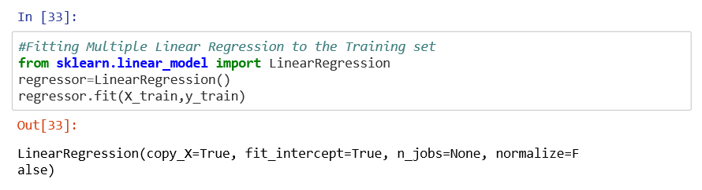
FITTING MULTIPLE LINEAR REGRESSION TO THE TRAINING SET

Slide 26
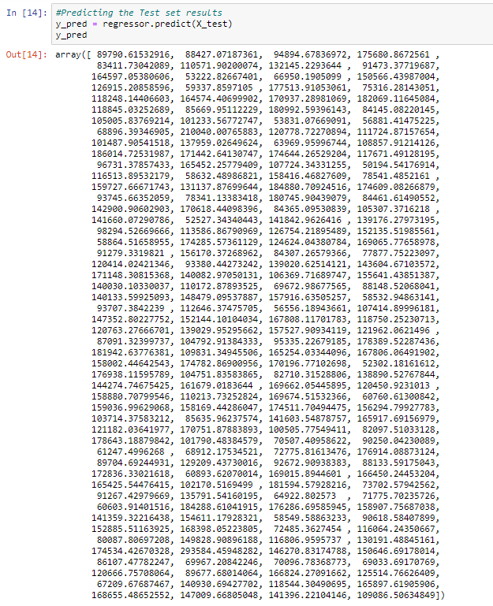
PREDICTING THE TEST SET RESULTS

Slide 27
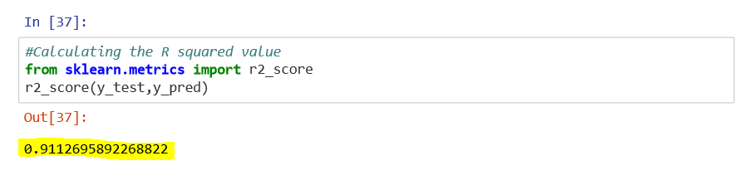
CALCULATING THE R SQUARED VALUE

Slide 28
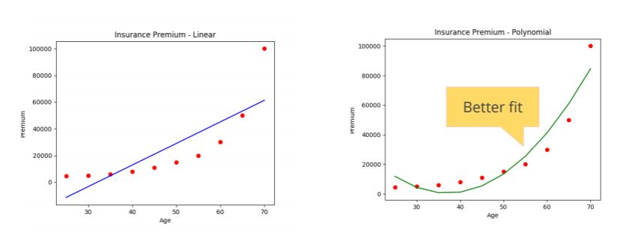
ALTERNATIVES TO LINEAR REGRESSION

Slide 29
CONCLUSION
Linear Regression is mostly used for finding out the relationship between variables and forecasting.
Different regression models differ based on – the kind of relationship between dependent and independent variables, they are considering and the number of independent variables being used.

Slide 30


